Slide 1
Hundo IST

Slide 2
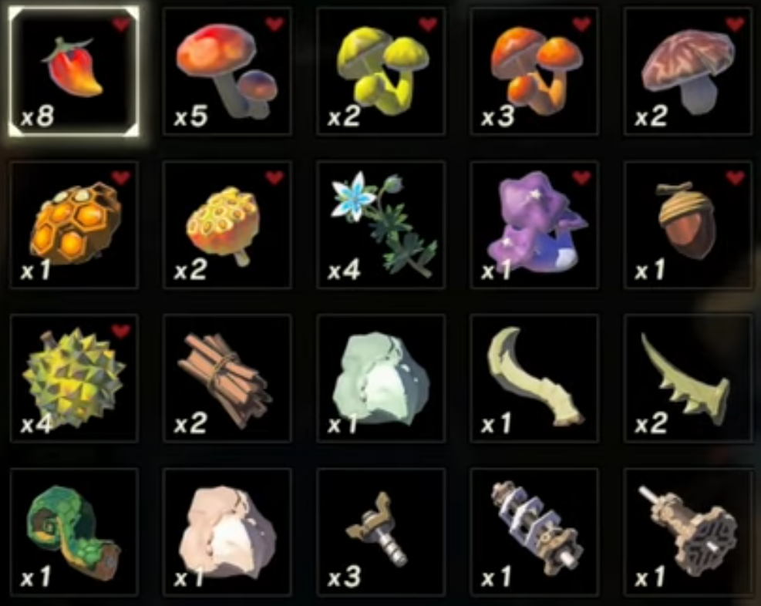
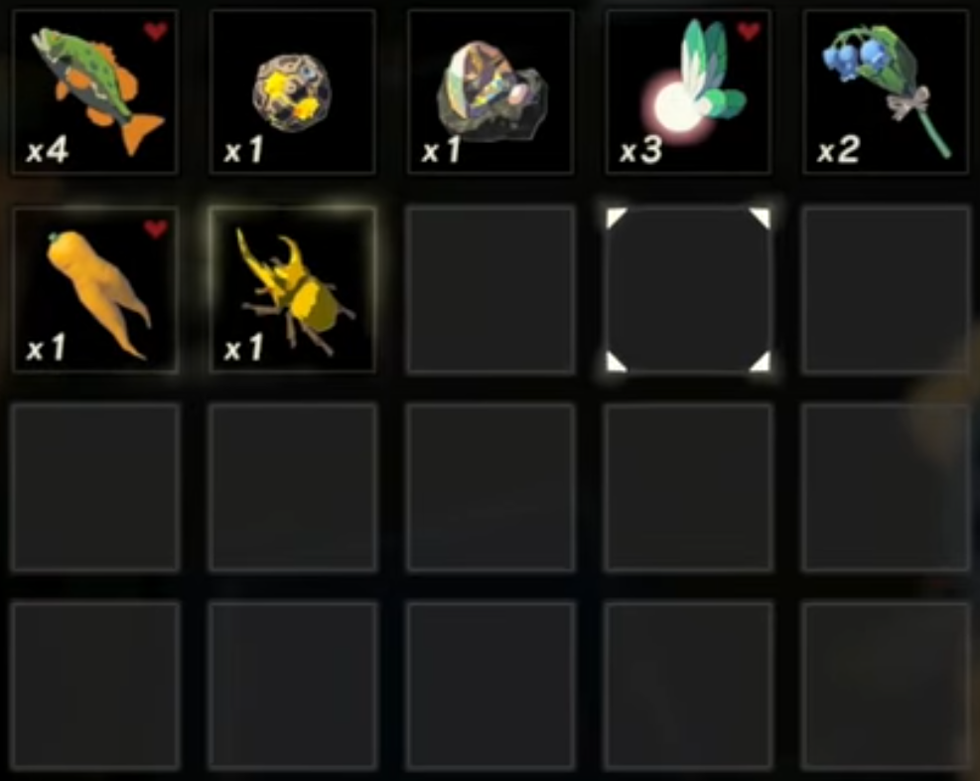
Starting Inventory

Slide 3
Break 12 Slots
Zap, Razor, Honey, Wood, Nightshade
pick up in order: Honey, Nightshade, Wood, Zap, Razor (EAT THIS)
DROP Hylian, Pepper, Sun, Durian
Hylian, Pepper, Sun, Durian, Spring
Hylian, Pepper, Sun, Durian, Zap

Slide 4
DROP and PICK UP
Rush, 3 Screws, Carrot
4 Bass
2 Lotus, Fang, Fang
2 Talon, Horn, Shaft (Pick up in that order?)
SAVE (optional move date up 1 day)
LOAD SoR for invalid Star tab
LOAD Kak

Slide 5
SORT Key Items
Drop 8 Korok Seeds
Mat 2 row 2 col 5 (cheat code <^><)
DROP and PICK UP
4 bass, 1 horn
2 lotus, 2 talon, 1 shaft
4 princess
SAVE
BREAK 2 slots using fairies
LOAD Kak

Slide 6
DROP and PICK UP
8 bass, 2 horn
4 princess
4 lotus
4 fang, 4 talon, 2 shaft
SAVE
LOAD Kak

Slide 7
DROP and PICK UP
8 talon
4 horn, 4 shaft
8 princess
GET all stamina and as many hearts as possible
BUY 1 fire arrow
EQUIP hylian shield, royal claymore, forest dweller's bow, fire arrow
SAVE
LOAD Plateau

Slide 8
EAT 3
LOAD Kak
SAVE
LOAD Kak
EQUIP club, falcon bow
DROP 5 cores, 1 acorn
SELL all cores
PICK UP cores, acorn
SAVE
LOAD Plateau

Slide 9
PICK UP spear
UNEQUIP spear
EAT 9
LOAD Kak
SHOOT arrow SAVE
LOAD Plateau

Slide 10
EAT 7
LOAD Kak
SHOOT arrow SAVE
LOAD Kak

Slide 11
PICK UP wooden bow
EQUIP wooden bow, ancient arrow
BUY swift carrot
SORT materials
DROP and PICK UP lotus
SAVE
LOAD Plateau

Slide 12
EAT 7
LOAD Kak
SHOOT arrow SAVE
LOAD Kak

Slide 13
EQUIP claymore and continue
EQUIP falcon for BTB then swap to fire arrows after
WMC Meal:
Roast endura, drop nightshade + wooden
Talk bolson, save, reload
COOK fang + 4 lotus
EAT 7 meals, sort TWICE, hold roasted carrot (meal 1 row 3 col 5 <^><)
COOK roasted carrot, princess, 3 fairies
EAT 2 meals, SAVE, RELOAD

